Slide 1
Team Echo
Dynamic Narrative

Slide 2
Introduction
DyNaMo (Dynamic Narrative Modelling)
We've built:
A graph editor to edit the narrative structure.
Simple Text and HTML based previewers.
A runtime library to build games with.

Slide 3
Idea!
Directed Acyclic Graphs
Use DAG to represent a narrative, with arcs representing short sections of story.

Slide 4
Idea!
Directed Acyclic Graphs
Use DAG to represent a narrative, with arcs representing short sections of story.
Synchronization Nodes

Slide 5
Idea!
Directed Acyclic Graphs
Use DAG to represent a narrative, with arcs representing short sections of story.
Synchronization Nodes
Choice Nodes

Slide 6
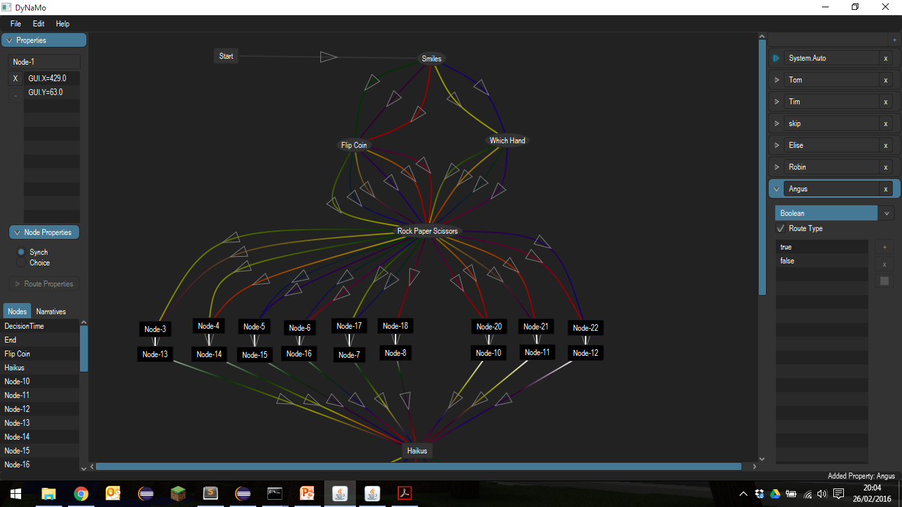

Slide 7
Design Choices
Flexible and Powerful
Design choices were designed to allow:
Easy extension.
Ability for functionality in the graph itself, or on top of, depending on designers decision.
Easy addition to a game engine.

Slide 8
Conclusion
DyNaMo can:
Handle complex decision trees as found in lots of games.
Handle multiple "simultaneous" story arcs, played in any order.
Handle complexity in the graph, if required.

Slide 9
Thanks for listening!
Special Thanks to:
Mark Ogilvie & JAGEX
The Computer Lab

